Slide 1
WARNING
We will be using practices that benefit larger projects more but offers little to smaller projects. Many of things we mention may seem unnecessary for a code base of this scale. This is on purpose to show you these technique exists and how they should be carried out!

Slide 2
Linked list

Slide 3
What to do now?
This will be …
A brief guide on how to create a linked list
A brief guide on how programs are designed in chronical order
This will NOT be …
An explanation of linked list
A step by step walk through of professor’s code

Slide 4
Before you start
Gain a big picture on what you are writing

Slide 5
Start small
Begin from pieces that every other piece depends on
Initialize and clean up
Document as you go
Essential parts
Meaning of each parameter
Meaning of return value
Side effects, e.g. print to console, file opened
……
Optional
Anticipated problems
Example usage

Slide 6
Start small
Test as you go
Initialize and clean up and seldom error, though
------------------------------------------------------------------------
Aftermath
Is there better implementation?
Better write down if any
Could there be some typical misuse?
Mention them in document!

Slide 7
Documentation & testing: side effect
Documentation & testing flushes any uncertainty
Writing documentation & tests …
Help you explore vast unknowns
e.g. document the parameters gives you a clear picture what you may handle
Help you identify bad design
e.g. identify behaviors that seems normal from an implementer's perspective but unusual from the caller’s perspective.

Slide 8
Continue enhancing
Work out what can to be added next
Removal?
Crazy. Nothing in the list yet.
Addition!
Insist add removal first?
Addition may assume a special layout in the list
May work forthis trivial task, not going to work in more difficult ones

Slide 9
Continue enhancing
The same checklist as for initialization and clean up
Documentation?
Testing?
This starts to become necessary
Be exhaustive
Be creative
Aftermath

Slide 10
A list of all functions implemented
bool add_list_head_element(LIST*, const LIST_DATA&);
bool remove_list_head_element(LIST*);
bool add_list_tail_element(LIST*, const LIST_DATA&);
bool remove_list_tail_element(LIST*);
bool add_current_list_element_before(LIST*, const LIST_DATA&);
bool add_current_list_element_after(LIST*, const LIST_DATA&);
bool add_list_element_before(LIST*, LIST_NODE*, const LIST_DATA&);
bool add_list_element_after(LIST*, LIST_NODE*, const LIST_DATA&);
bool remove_current_list_element(LIST*);
bool remove_list_element(LIST*, LIST_NODE*);
bool move_list_pointer_to(LIST*, int);
bool destroy_list(LIST*);
int get_list_count(LIST*);
LIST_NODE* get_list_head(LIST*);
LIST_NODE* get_list_tail(LIST*);
LIST_DATA& get_list_element(const LIST_NODE*);
void set_list_element(LIST_NODE*, const LIST_DATA&);
void print_list(LIST*);

Slide 11
ed--
Part 2

Slide 12
Recap
Line based editor
One buffer per line
Implemented Replacement and searching

Slide 13
Spec has changed!
A new functionality: sorting
The same as your homework 3
Sort the whole file in ascending or descending alphabet order
The command for this functionality would be
sa: sort in ascending order
sd: sort in descending order

Slide 14
Spec has changed!
Program must be able to handle files with at least 10k lines!

Slide 15
Today’s menu
Implement command a, sa and sd

Slide 16
Problem
Command “a”
Append a line means a new line buffer
This addition could happen in the middle of file!
We used to hold all pointers to a line buffer in an dynamic array
Shift every pointer after inserted line!
Super inefficient!
Solution: replace dynamic array with a doubly linked list!
How?
Refactoring

Slide 17
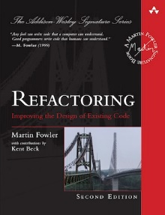
Refactoring?
A dramatic change to existing code base is called refactoring
Refactoring can be time consuming, difficult and error prone
Refactoring can be and often is necessary
(Mostly) cheaper than restart from scratch

Slide 18
What refactoring is?
Replace an obsolete part with an up-to-date one
Clean up hard coded behaviors
Decouple functional units within program
Fixing manageable systematic problems
e.g. every minor change requires changing a dozens of source files
……

Slide 19
What refactoring is not?
Rename a local variable
Fix a trivial bug
Add comments
Repair a piece of code that just don’t work
e.g. four years old project with no release
……

Slide 20
Refactoring considerations: before
Is this necessary?
Rarely change existing working code when alternatives exists
Refactoring can be time consuming, difficult and error prone
In our case,
dynamic array may work for smaller files
definitely not going to work on larger files
which we want to handle
So it is necessary

Slide 21
Refactoring considerations: before
What we will do?
Replace dynamic array with linked list
What code we have now rely on replaced part?
line_replace and line_search
We don’t have anything else anyway
What marks our refactoring is a success?
line buffers being managed in linked list
efficient line insertion
existing functions does not drop in performance too significantly

Slide 22
Refactoring considerations: before
How will this refactoring impact future development?
Performance?
Sort function?
Memory usage?
Some super useful function we may add later?
Accessing lines?
……

Slide 23
Design considerations
We need random access
User may insert a line after line 3, then want to print the line 2181
Buzzword: Random Access (随机访问)
Read or write to element with arbitrary index inside collection
Recall lectures
Compromise

Slide 24
Design considerations
Won’t this bring the performance back down to dynamic array?
Sometimes, yes
e.g. insert and print in alternation
Sometimes, not
insert multiple lines at once
Solution: Postpone write to node array
Alternative: LRU cache
Better, but beyond our scope
Left as an exercise for readers

Slide 25
Next?
Start coding?
NO.
Remember we did implemented a linked list before?
With good encapsulation you can reuse much of that code

Slide 26
A list of all functions implemented
bool add_list_head_element(LIST*, const LIST_DATA&);
bool remove_list_head_element(LIST*);
bool add_list_tail_element(LIST*, const LIST_DATA&);
bool remove_list_tail_element(LIST*);
bool add_current_list_element_before(LIST*, const LIST_DATA&);
bool add_current_list_element_after(LIST*, const LIST_DATA&);
bool add_list_element_before(LIST*, LIST_NODE*, const LIST_DATA&);
bool add_list_element_after(LIST*, LIST_NODE*, const LIST_DATA&);
bool remove_current_list_element(LIST*);
bool remove_list_element(LIST*, LIST_NODE*);
bool move_list_pointer_to(LIST*, int);
bool destroy_list(LIST*);
int get_list_count(LIST*);
LIST_NODE* get_list_head(LIST*);
LIST_NODE* get_list_tail(LIST*);
LIST_DATA& get_list_element(const LIST_NODE*);
void set_list_element(LIST_NODE*, const LIST_DATA&);
void print_list(LIST*);
This looks good
Add node array and it is finished

Slide 27
Design considerations
How to sort?
Bubble sort?
Terrible performance
Quick sort?
Viable
More work load than random access version
Merge sort
Similar performance.
Does not require random access whatsoever

Slide 28
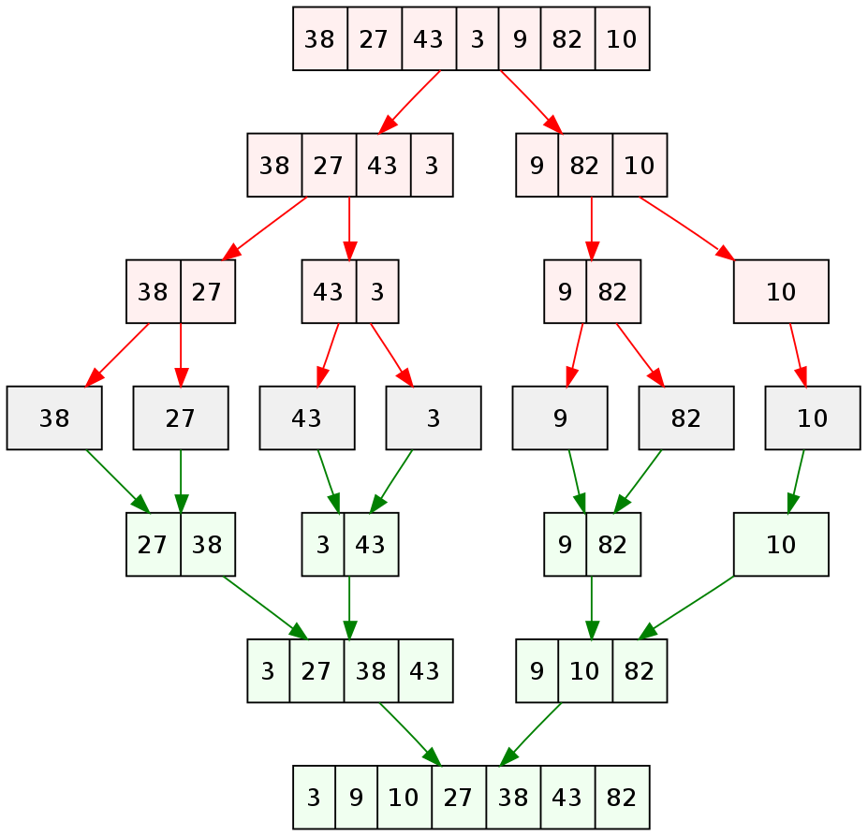
Merge sort
A recursive sort algorithm
Still divide and conquer
Basic idea
Cut list in half until undividable
Merge pieces together while reordering pieces so that an order is established

Slide 29
Reference implementation
We will not present a reference implementation
We are moving away from the rudimentary part of teaching language basics
We will strength our emphasis on design related topics even more

